Slide 1
Obstacle avoidance for a differential drive robot
Project exam 2017

Slide 2
ED5-8-16
Project participants:
Philip Philev
Mihkel Soolep

Slide 3
Content of presentation

Slide 4
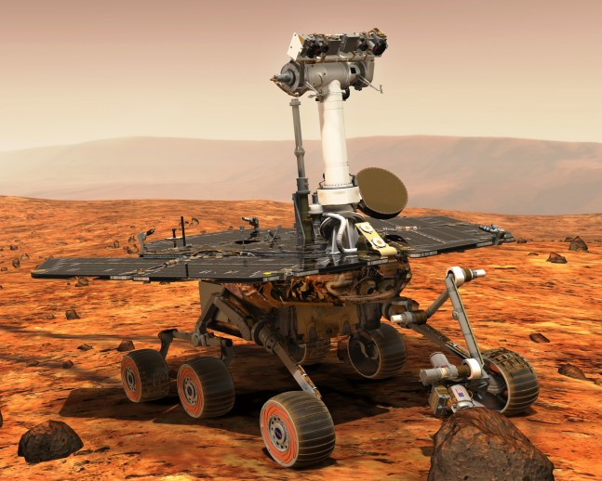
Background of topic choice
Increasing interest in the field of autonomous robotics, including vehicles and mobile robots.
Drastic decrease in prices for individual components.
- LIDAR, used in Google’s self-driving car project, was priced at 75.000$ in 2007.¹
- In 2017 Commercial LIDARs can be found for as low as 100$. Further price drop expected.
- Could result in increased interest from enthusiasts as well as developers.
Excellent way to obtain knowledge of the different
subsystems that compose an autonomous vehicle.
Large number of practical applications
Figure 1: Opportunity (Mars Exploration Rover – B)²

Slide 5
Differential wheeled robot
General idea behind the choice
Extensive use in robotics.
Low cost.
Adjustable for different applications.
Depending on size, can better manouver in closed spaces
Techical details
Two wheels controlled separately
Varying the rates of rotation of the wheels changes direction
Requires appropriate control to maintain a desired trajectory.

Slide 6
Desired implementations

Slide 7
Mathematical representation

Slide 8
Matlab implementation

Slide 9
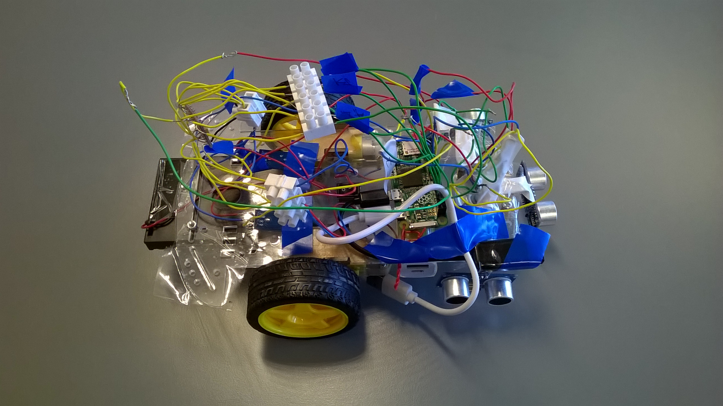
Hardware used in development
Raspberry Pi Zero
3 x HC-SR04 ultrasonic sensor
2 x 6V DC motors and chassie
TB6612FNG motor driver
2 x LM393 IR speed sensors

Slide 10
Development
Motors and driver testing
First driver problems
Second driver
while True:
print "TEST!!!!"
forward()
time.sleep(2)
reverse()
time.sleep(2)
left()
time.sleep(2)
right()
time.sleep(2)
off()

Slide 11
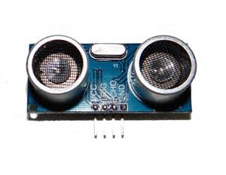
Development
Ultra sonic sensors
Timing
Delimitations: max distance(4m), time(according to distance)

Slide 12
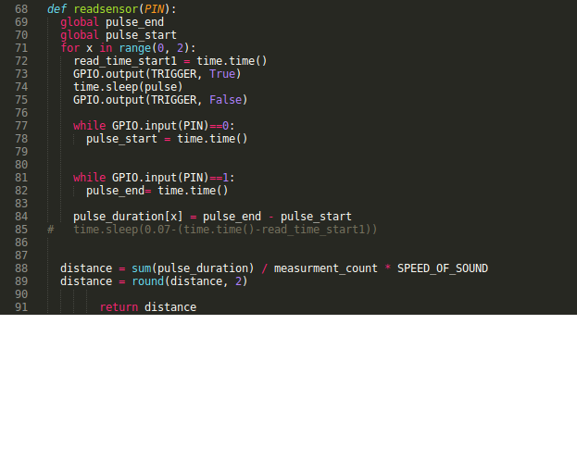

Slide 13
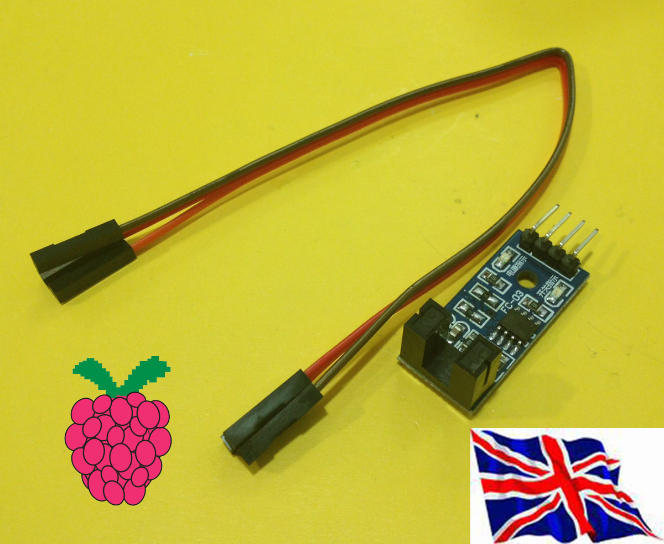
Development
Encoder
PID implementation
Problems

Slide 14
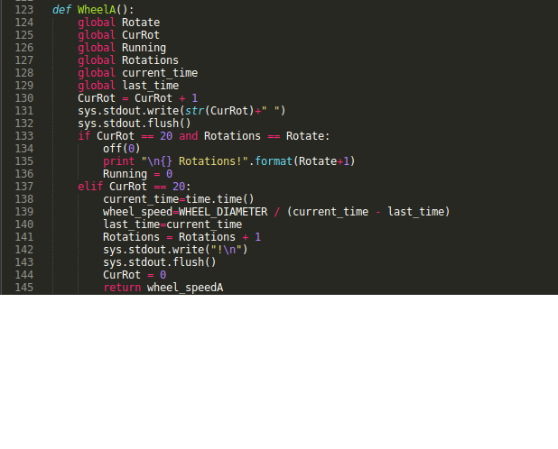

Slide 15
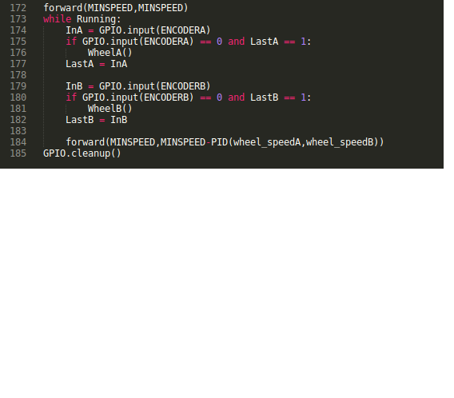

Slide 16
Final software/logic
1. States for robot
2. Sensor readings
3. Changes the driver input according to the state derived from the sensors(FORWARD, REVERSE, LEFT, RIGHT)

Slide 17
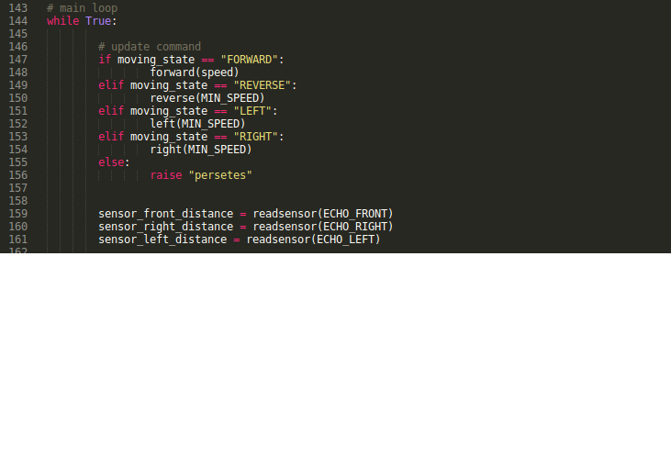

Slide 18
